Slide 1


DR. YIZHEN ZHAO
GROUP 1
Ronak Patil - 001007035
Dhaval Patel - 001566811
Sindhuja Vaddi - 002198939
Harshit Parikh - 001044838
Nikita Gaurihar - 002980962
Siddhi Telang - 002198703

Slide 2
Introduction
Tesla, Inc. is an American electric vehicle and clean energy company founded in 2003 by entrepreneur and innovator Elon Musk.
Tesla's stock has been one of the most talked-about in recent years, with a significant increase in value over the past decade.
Tesla's stock (TSLA) had an incredible year in 2020, starting the year at around $86 per share and reaching an all-time high of over $880 per share in early 2021. This rise in value was due to a combination of factors, including increased demand for electric vehicles, strong financial performance, and optimism about the company's future growth potential.

Slide 3





Competitors

Slide 4
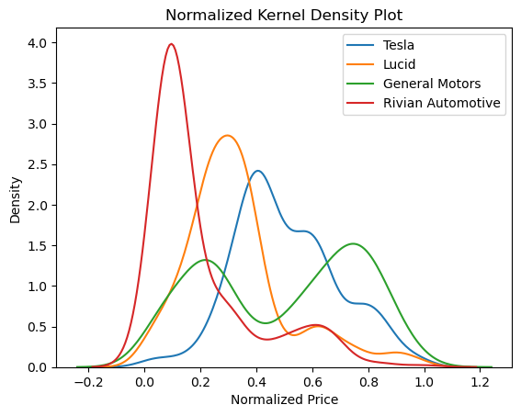
Kernel Density
The code creates a figure with a Kernel Density Plot for the 'Adj Close' stock prices of TESLA and its competitor's stocks. It prints out the descriptive statistics for the 'Close' and 'High' data.

Slide 5
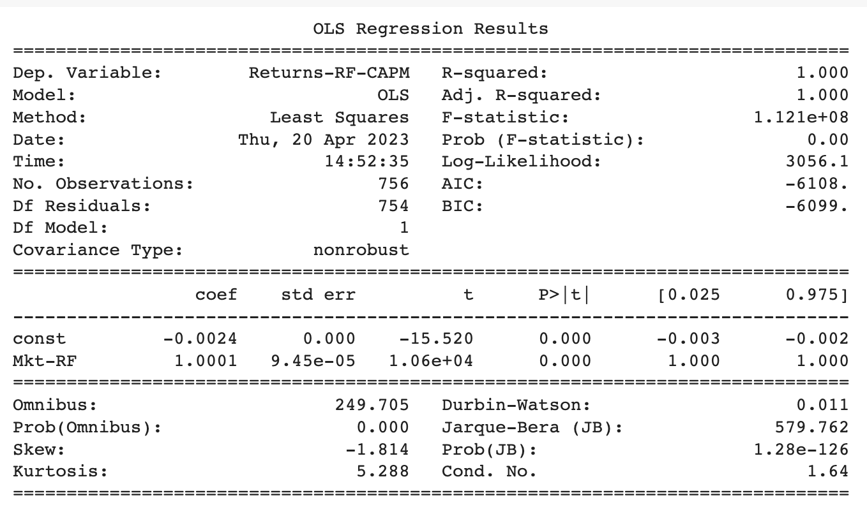
CAPITAL ASSET PRICING MODEL
The Capital Asset Pricing Model (CAPM) is a financial model that helps to determine the expected return on an investment based on the risk-free rate of return, the expected market return, and the systematic risk of the investment, also known as beta.

Slide 6
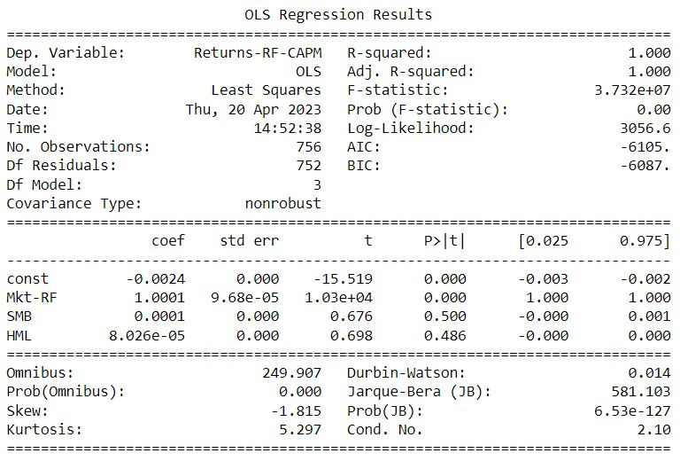
FAMA-FRENCH
The Fama-French model is a statistical asset pricing model that uses factors to explain the returns of investment portfolios. The model was developed by Eugene Fama and Kenneth French in the 1990s, and it has become widely used in the finance industry to analyze investment performance.

Slide 7
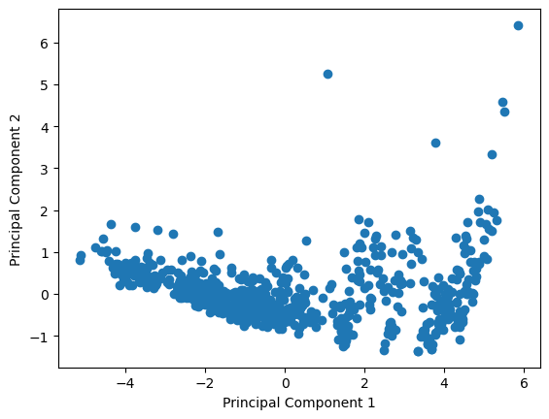
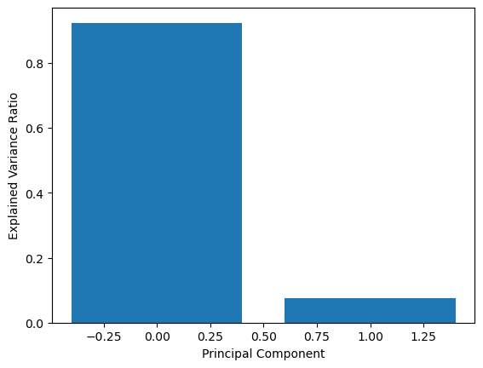
PRINCIPLE COMPONENT ANALYSIS
PCA is a statistical technique that is commonly used to reduce the dimensionality of a large dataset while retaining as much information as possible. It aims to transform a set of correlated variables, known as features or attributes, into a smaller set of uncorrelated variables called principal components. These principal components are linear combinations of the original features and are sorted in descending order of their variances, with the first component explaining the most variance in the data.

Slide 8
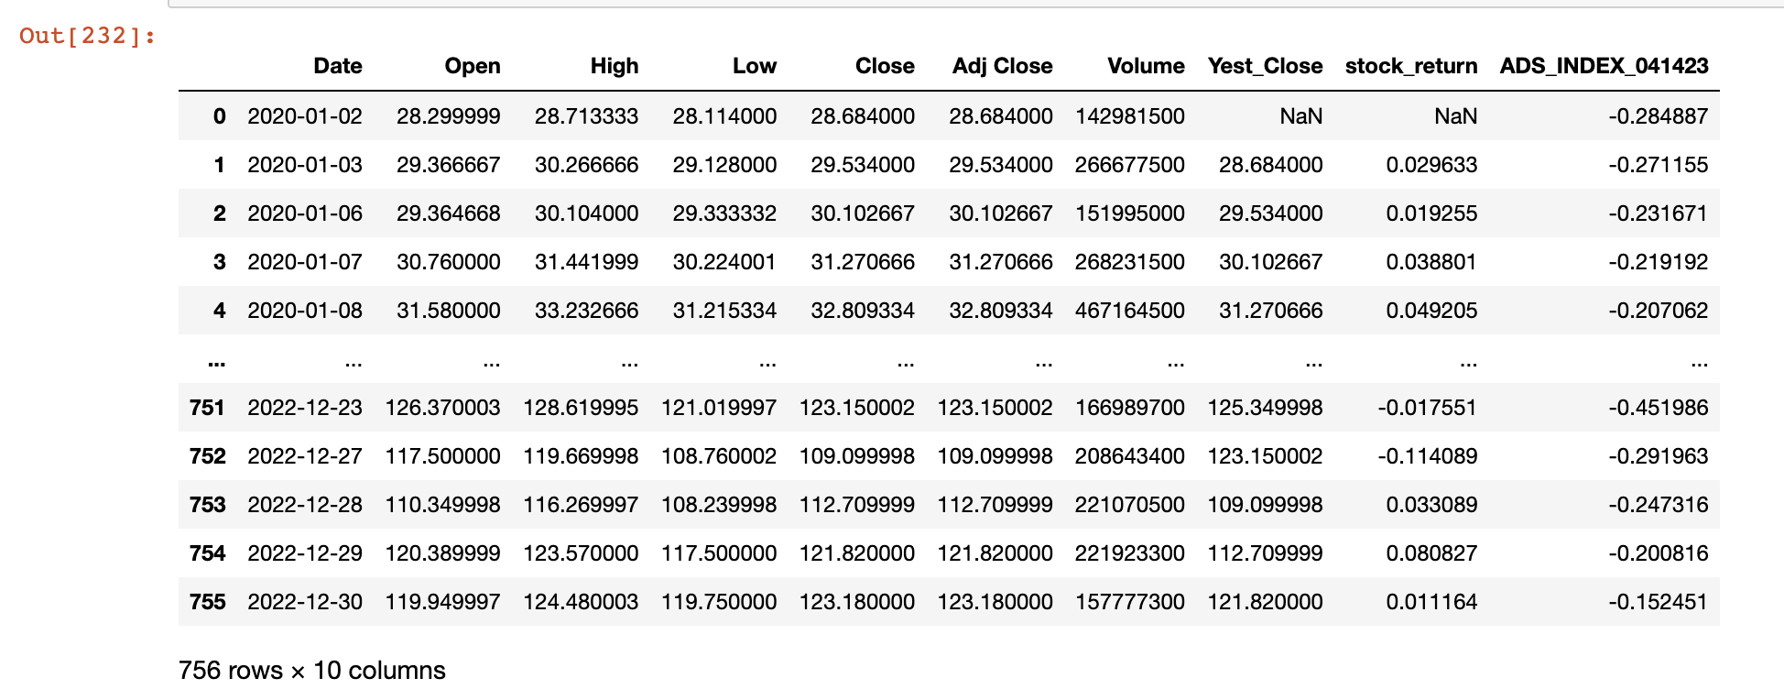
ADS
Aruoba-Diebold-Scotti (ADS) is a method of measuring the current state of the economy in real-time. It uses a statistical model to combine a wide range of economic data, such as employment rates, inflation, and consumer spending, into a single number that reflects the overall health of the economy.

Slide 9
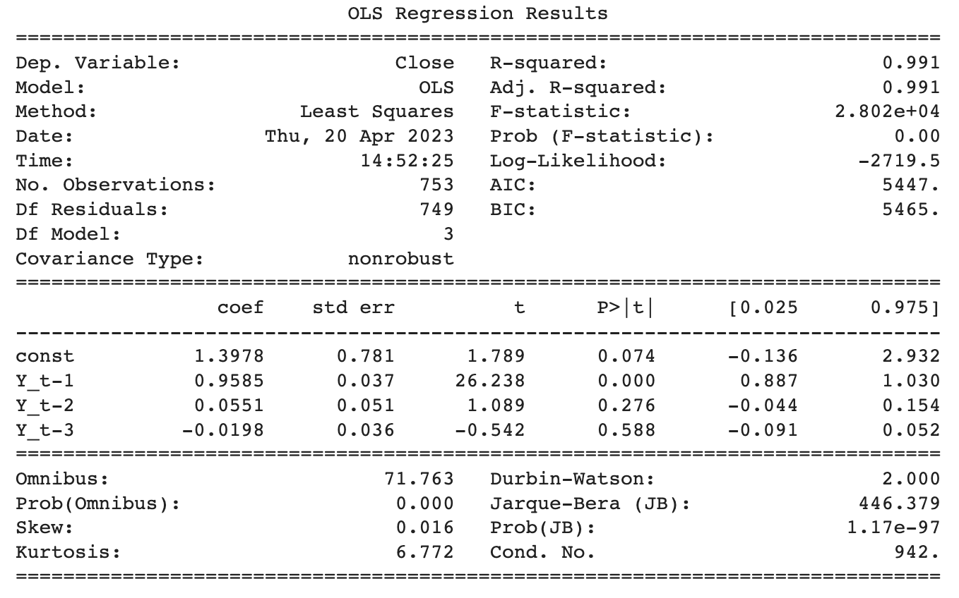
ARIMA - AR3
Candidate Model 3
𝑌𝑡 = 𝛼0 + 𝛼1𝑌𝑡 ― 1 + 𝛼2𝑌𝑡 ― 2 + 𝛼3𝑌𝑡 ― 3 + 𝜀𝑡

Slide 10
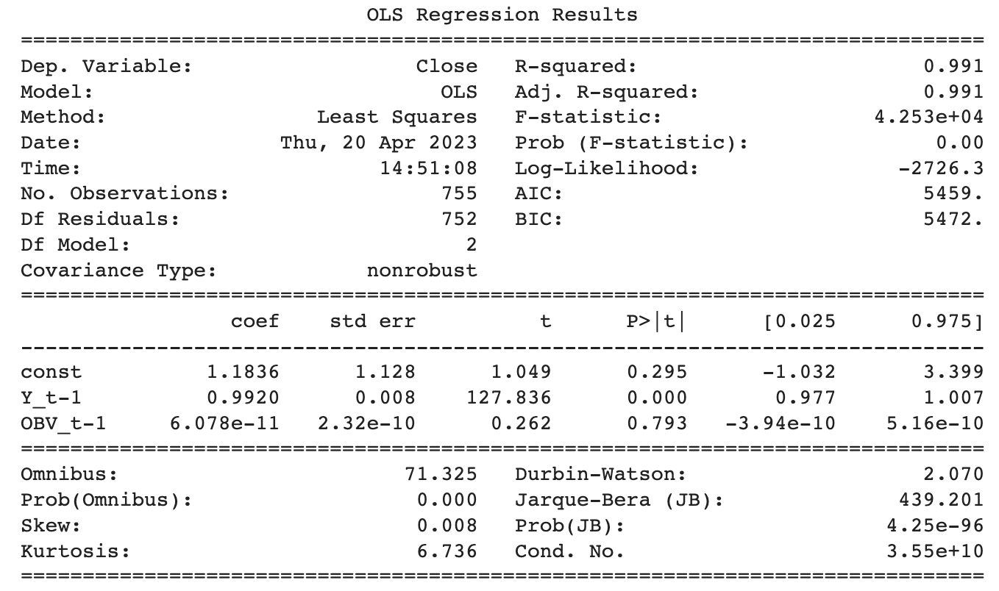
ARIMA
ARIMA - Autoregressive Integrated Moving Average, is a popular time series forecasting method in machine learning. It is a model that is used to analyze and predict future values of a time series based on its past behavior.

Slide 11
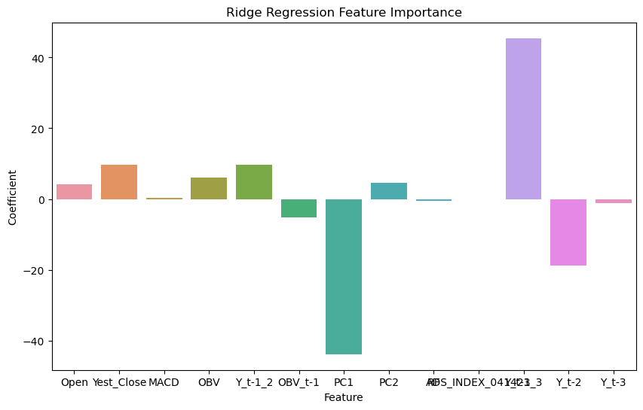
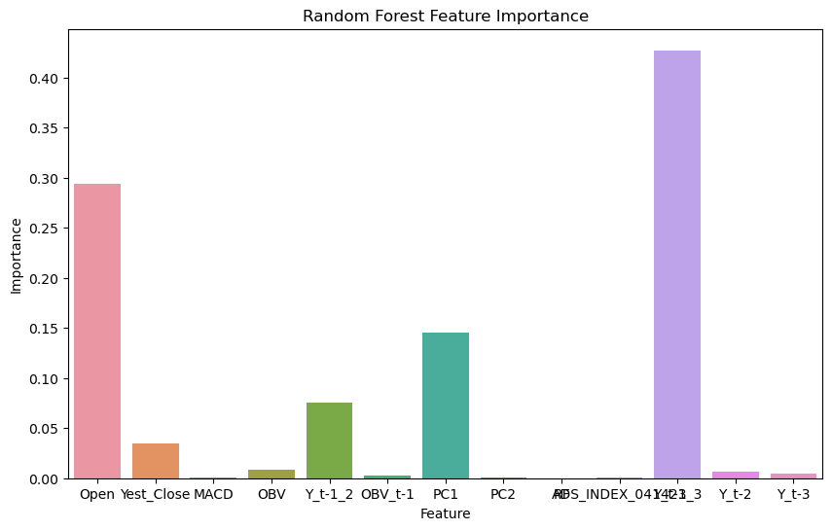
Feature importance and feature selection

Slide 12
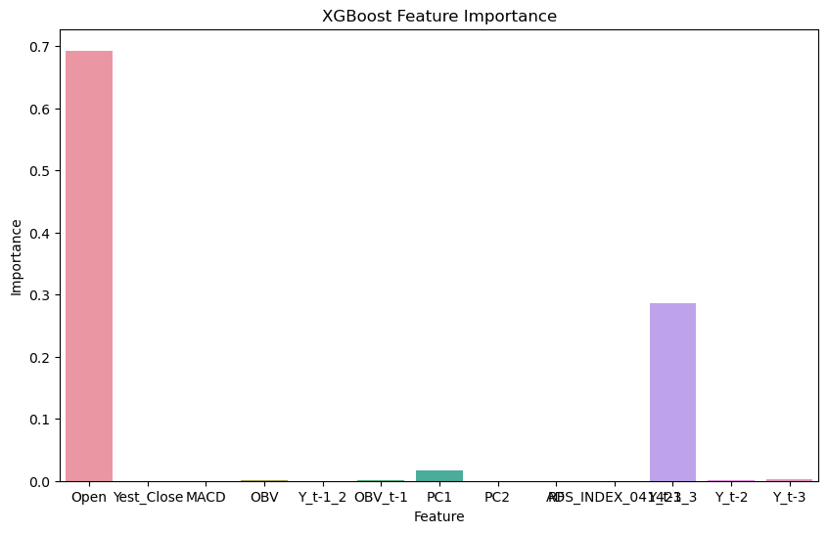
Feature importance and feature selection

Slide 13
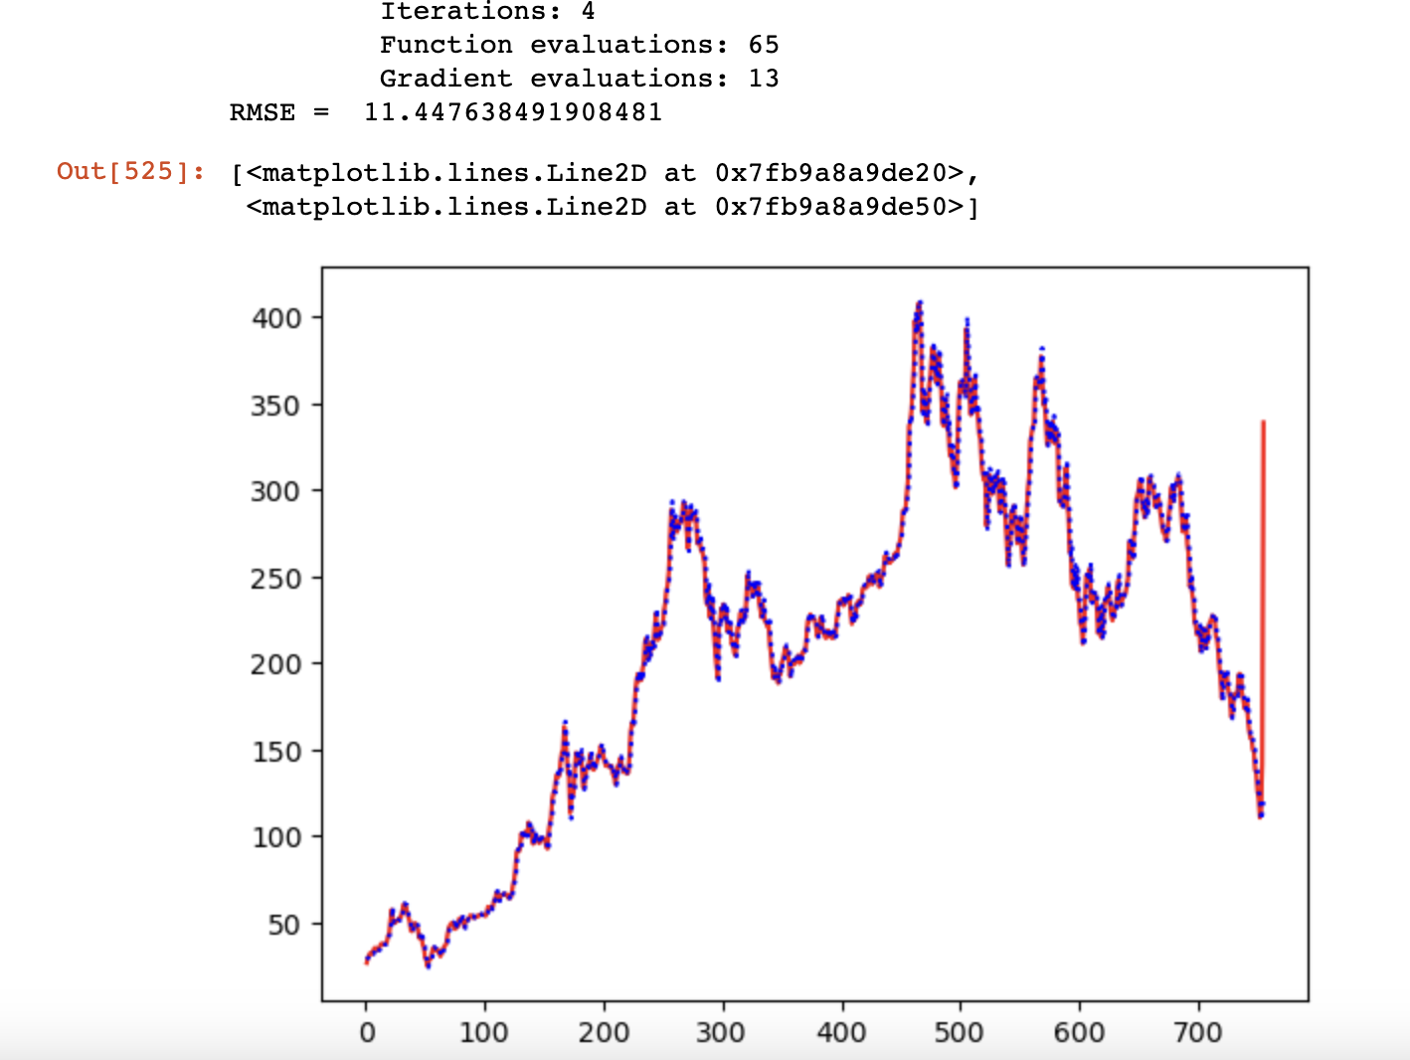
GARCH - KALMAN filtering
GARCH filtering is widely used in finance and economics to estimate the volatility of financial time series data, such as stock prices or exchange rates. It is used to estimate risk and to identify opportunities for trading and investment.
The Kalman filter is often used in situations where measurements are noisy or incomplete, and where it is necessary to estimate the underlying state of a system in real-time. It is widely used in applications such as aerospace, robotics, and finance.

Slide 14
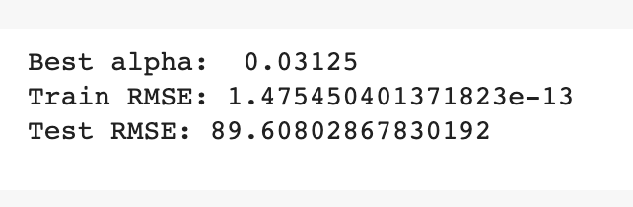
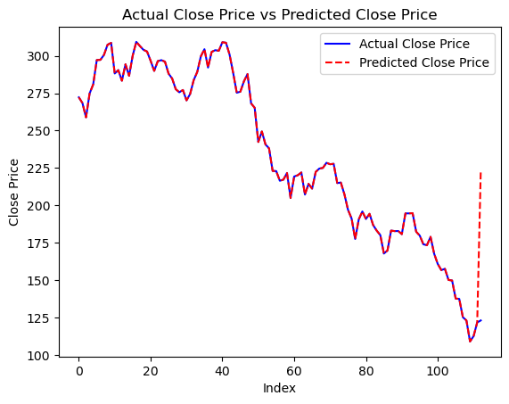
RIDGE REGRESSION
Ridge regression is a type of linear regression that is used to handle the problem of multicollinearity in the independent variables. Its also is a popular method in machine learning for regression tasks, particularly when dealing with datasets with high dimensional and correlated features.

Slide 15
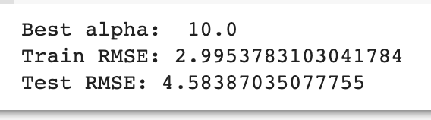
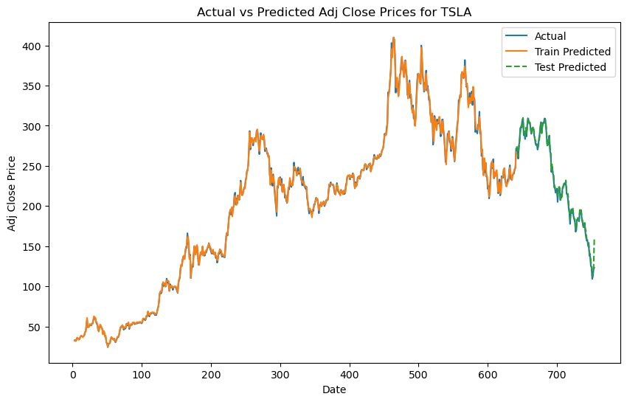
LASSO REGRESSION
Lasso regression is a linear regression technique used for feature selection and regularization. The goal of lasso regression is to find the set of coefficients that best predict the target variable, while simultaneously shrinking the coefficient values towards zero.

Slide 16
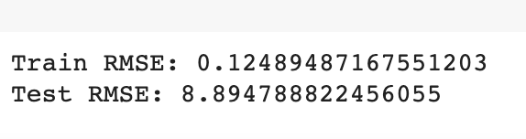

xgboost
The XGBoost algorithm is based on the gradient boosting framework, which combines multiple weak predictive models to form a stronger overall model. XGBoost uses decision trees as the base learner, which are trained sequentially and optimized to minimize a specific loss function.

Slide 17
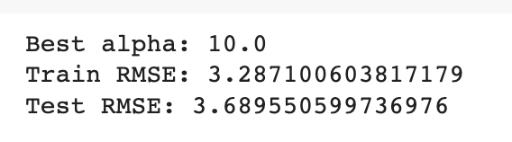

Elastic net
Elastic net is a linear regression technique that combines the advantages of both Lasso and Ridge regression techniques. The elastic net method helps to overcome some of the limitations of the Lasso method, which can be unstable when there are highly correlated predictors, by introducing the Ridge penalty term.

Slide 18
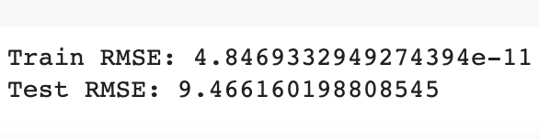

Least angle regression AND SHRINKAGE (lars)
Least Angle Regression (LARS) is a regression algorithm used for linear regression and variable selection. It is a powerful regression algorithm that can be used for both variable selection and prediction and is particularly useful for high-dimensional data sets.

Slide 19
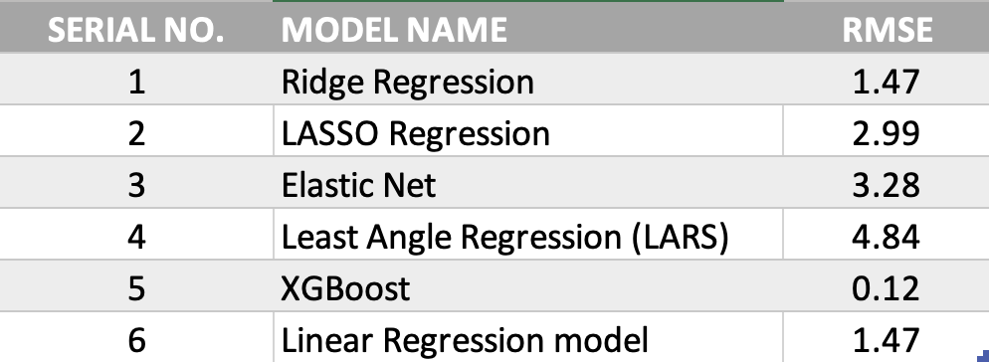
RMSE
RMSE is useful when comparing the performance of different models, as it provides a single numerical value that can be easily interpreted.

Slide 20
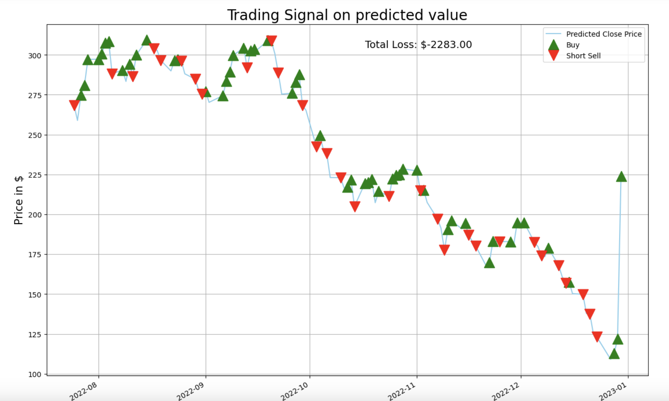
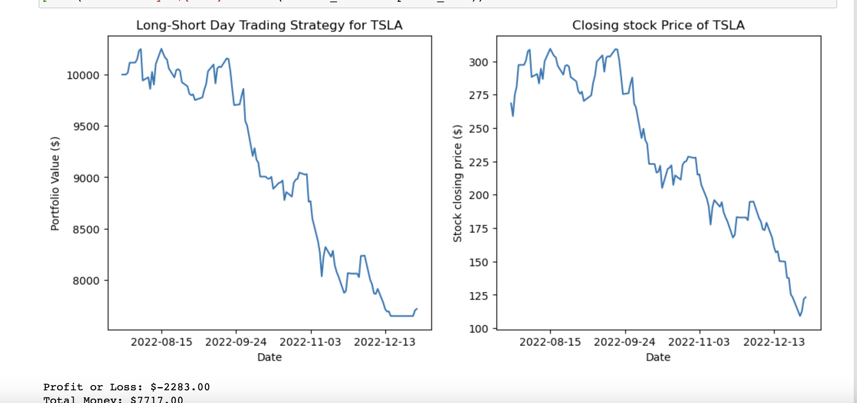
RIDGE REGRESSION TRADING SIGNAL

Slide 21
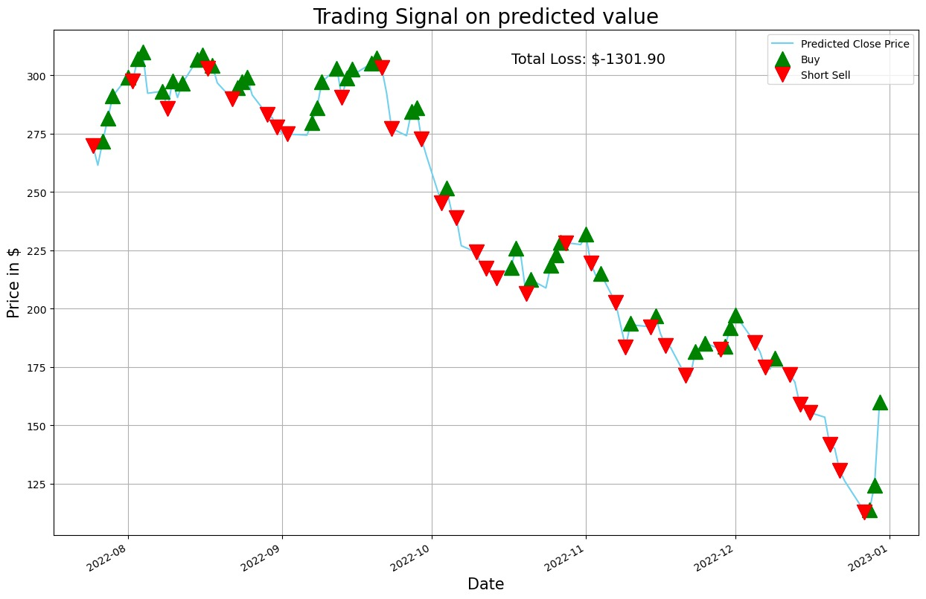
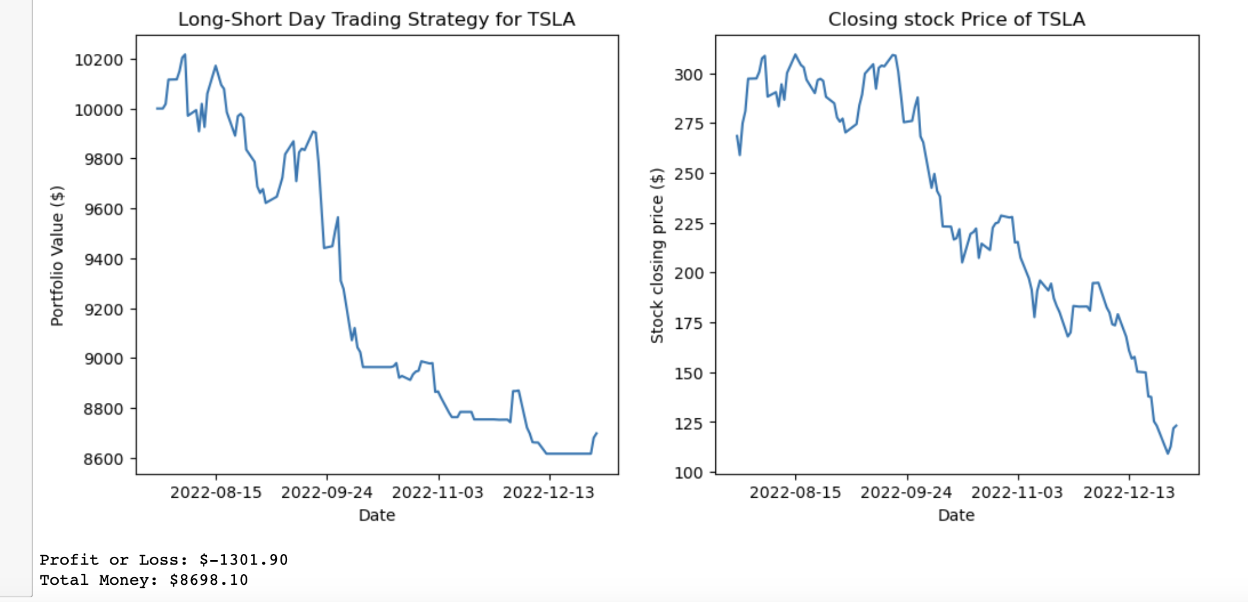
LASSO REGRESSION TRADING SIGNAL

Slide 22

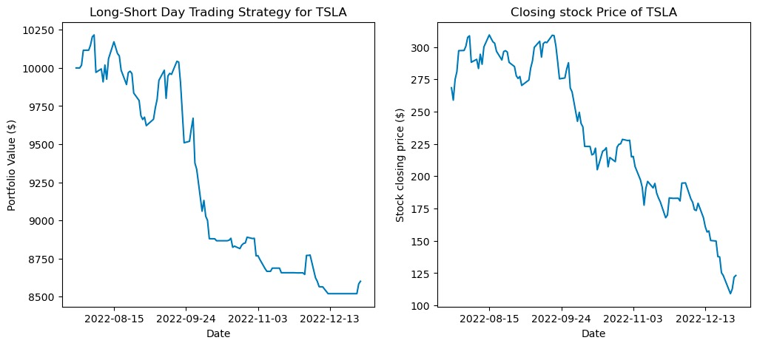
ELASTIC NET TRADING SIGNAL

Slide 23
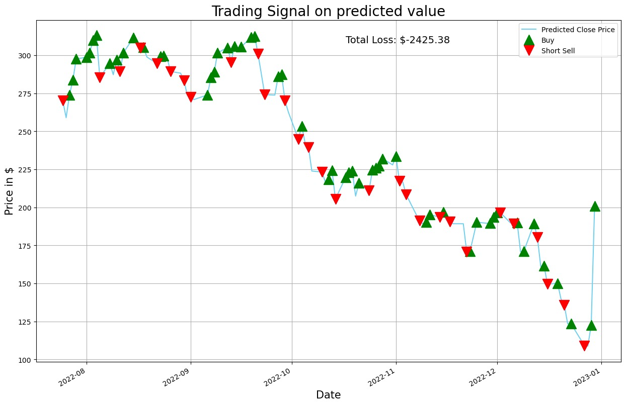
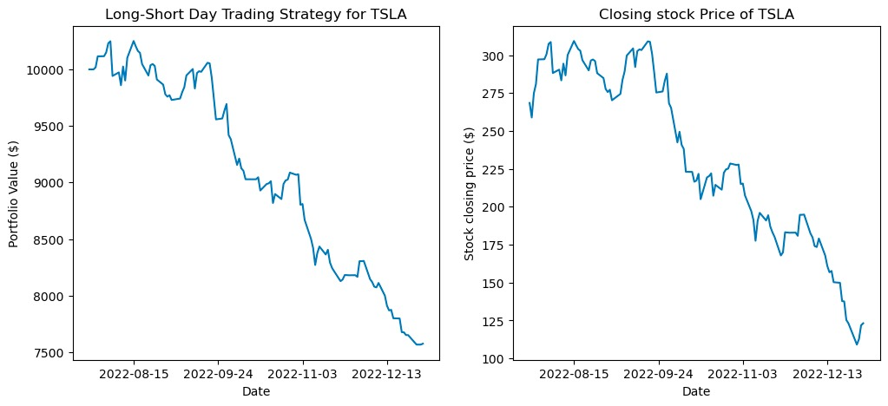
XGBOOST TRADING SIGNAL

Slide 24
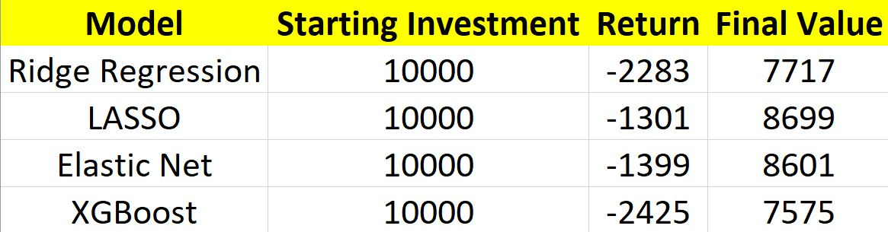
Comparing trading signals using above 4 models
SUMMARY

